Slide 1

Nothing to fear but Anxiety itself
A Consideration of the Molecular Mechanisms Associated with Fear and Anxiety
Jazmine Yaeger

Slide 2

Fear
Reaction to Known or Existing Threat
Objective Origin
Anxiety
General Response to Unknown Threat or Internal Conflict
Subjective Origin
Steimer, T 2002. Dialogues in clinical neuroscience 4, 231.

Slide 3
Prediction:
Fear can be separated from Anxiety (in part) by considering specific molecular mechanisms
Amygdala → basolateral amygdala
Neurofascin
Gephyrin
(which may be dependent on brain region, cell type, etc.)
Fear not → I’ll describe these later

Slide 4
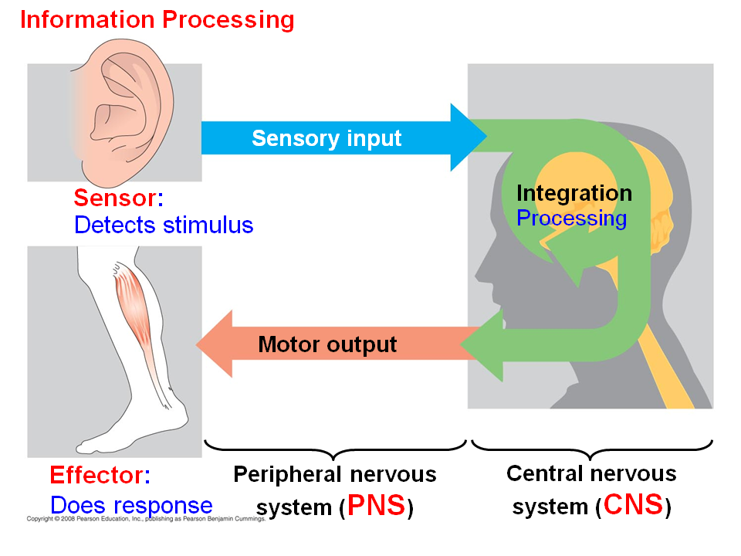
Is there truly a difference?
Differences should result in...
  Unique onsets (stimuli)
  Distinguishable neural circuits/mechanisms
  Distinctive behavioral outputs
Importantly
Often the terms are used interchangeably
Perusini, JN & Fanselow, MS 2015. Learning & Memory 22, 417-425.

Slide 5
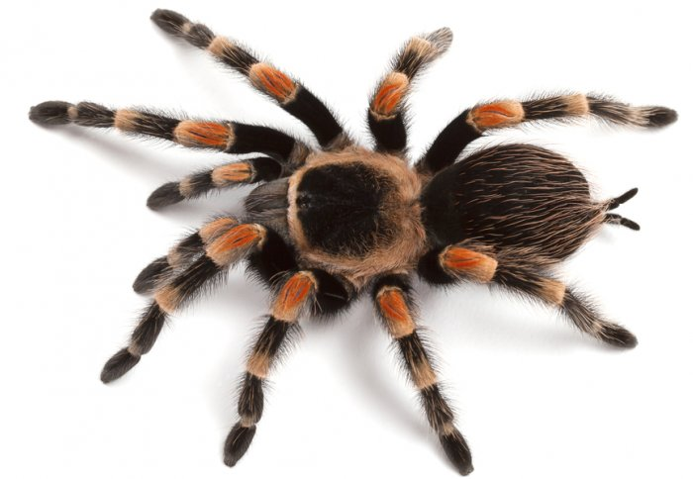

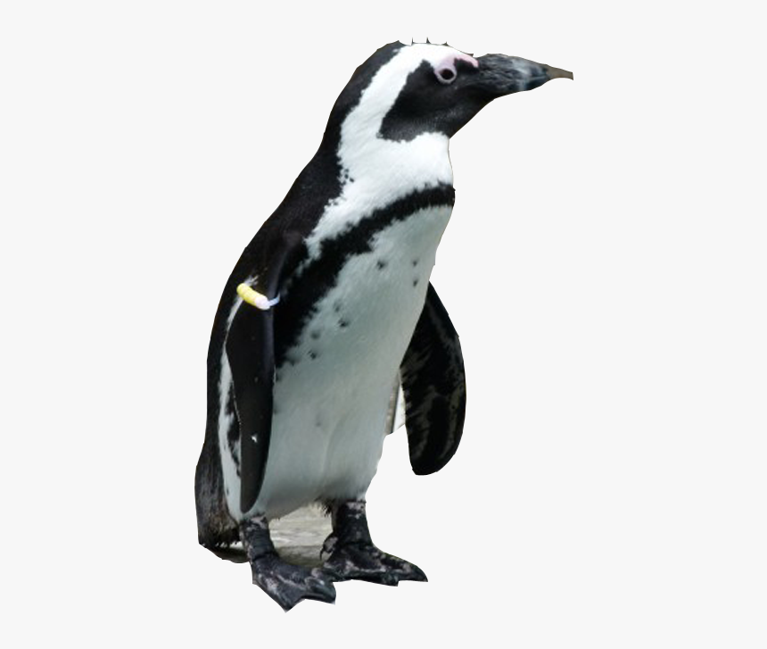

Unique Onsets (Stimuli)
Specific Phobia
Post-Traumatic Stress Disorder
(PTSD)

Slide 6

Unique Onsets (Stimuli)
Generalized Anxiety Disorder
(GAD)

Slide 7
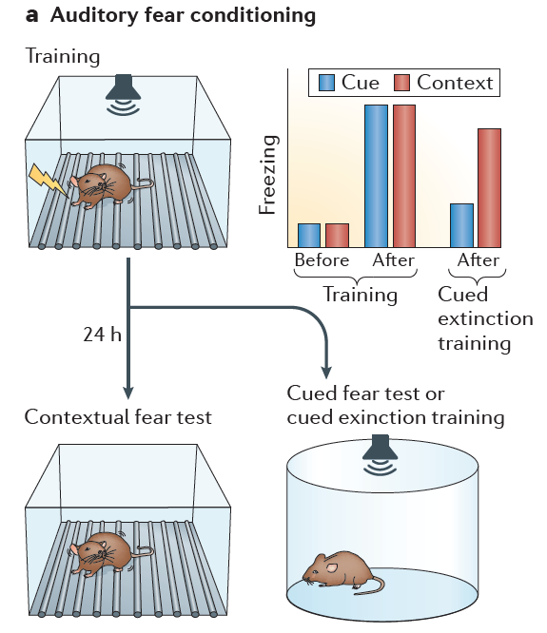
  Distinctive Behavioral Outputs
Fear Conditioning
Model for PTSD
Tovote, P., et al. 2015. Nature Reviews. Neuroscience 16(6): 317.

Slide 8
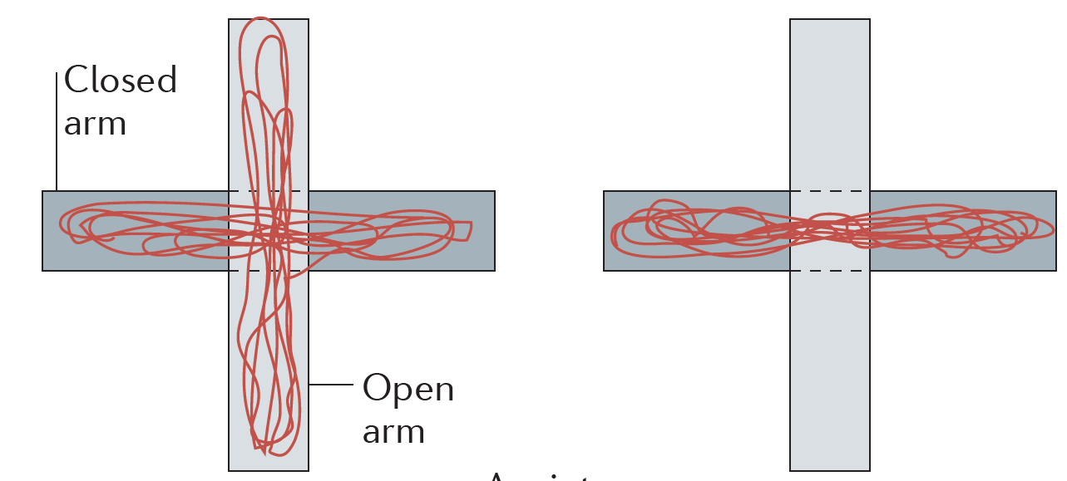
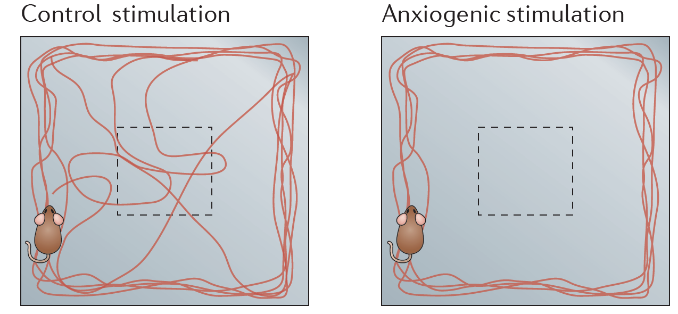
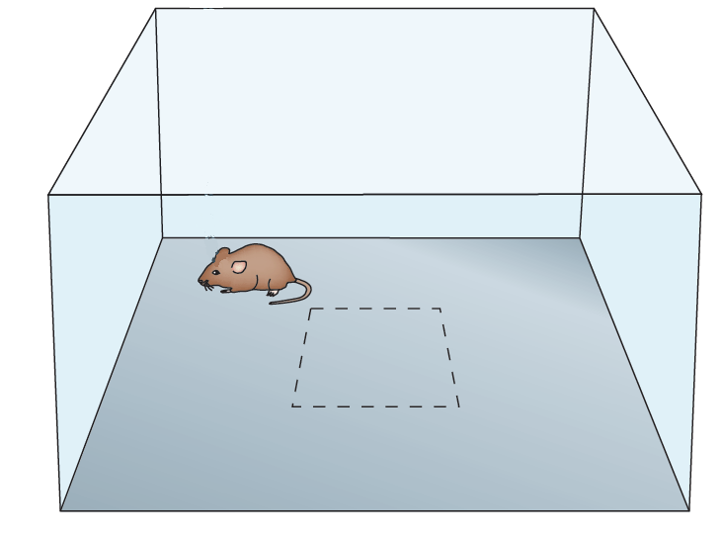
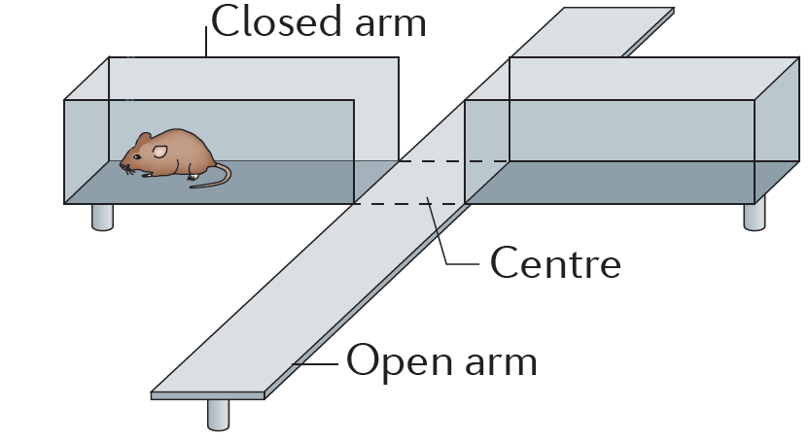
  Distinctive Behavioral Outputs
Tests of Generalized Anxiety
Open Field Test (OF)
Elevated Plus Maze (EPM)
Tovote, P., et al. 2015. Nature Reviews. Neuroscience 16(6): 317.

Slide 9
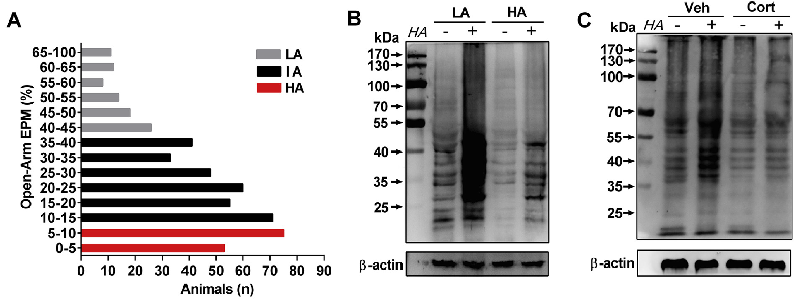
  Distinctive Behavioral Outputs
Tests of Generalized Anxiety
Shen, Z.-C. et al. 2019. Biological Psychiatry 85:202-213.

Slide 10
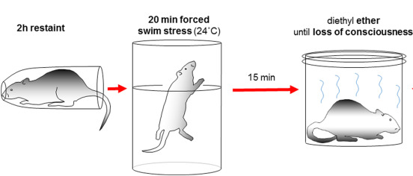
  Distinctive Behavioral Outputs
Single Prolonged Stress Model
Török, B., et al. 2019. Progress in Neuro-Psychopharmacology and Biological Psychiatry 90:117-133.

Slide 11
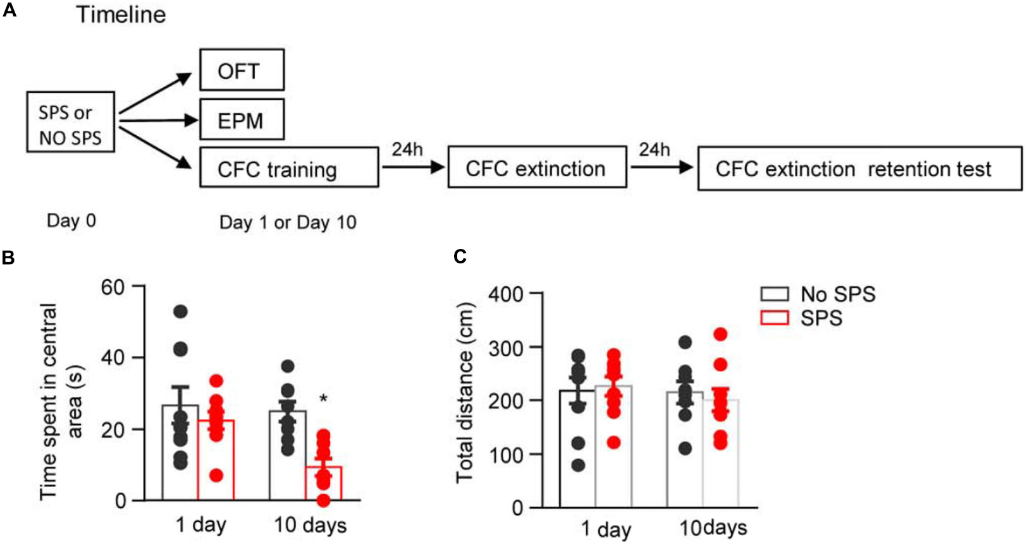
  Distinctive Behavioral Outputs
Single Prolonged Stress Model
Open Field Test (OF)
Fang, Q., et al. 2018. Frontiers in neuroscience 12:387

Slide 12
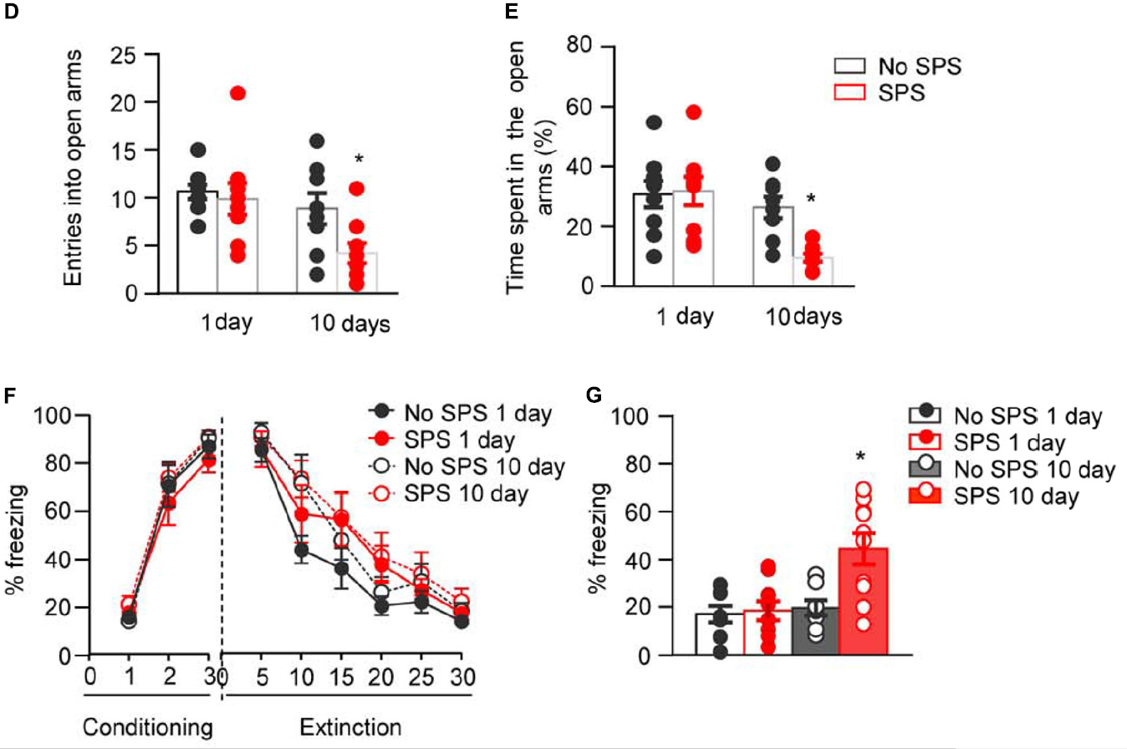
  Distinctive Behavioral Outputs
Single Prolonged Stress Model
Elevated Plus Maze (EPM)
Fang, Q., et al. 2018. Frontiers in neuroscience 12:387

Slide 13
  Distinctive Behavioral Outputs
Single Prolonged Stress Model
Fang, Q., et al. 2018. Frontiers in neuroscience 12:387

Slide 14
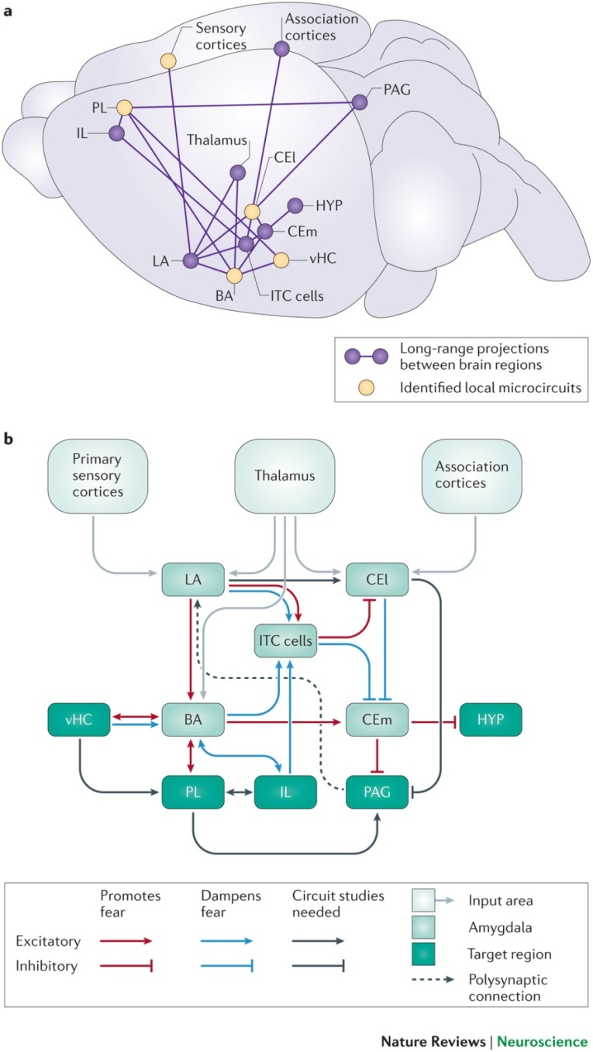
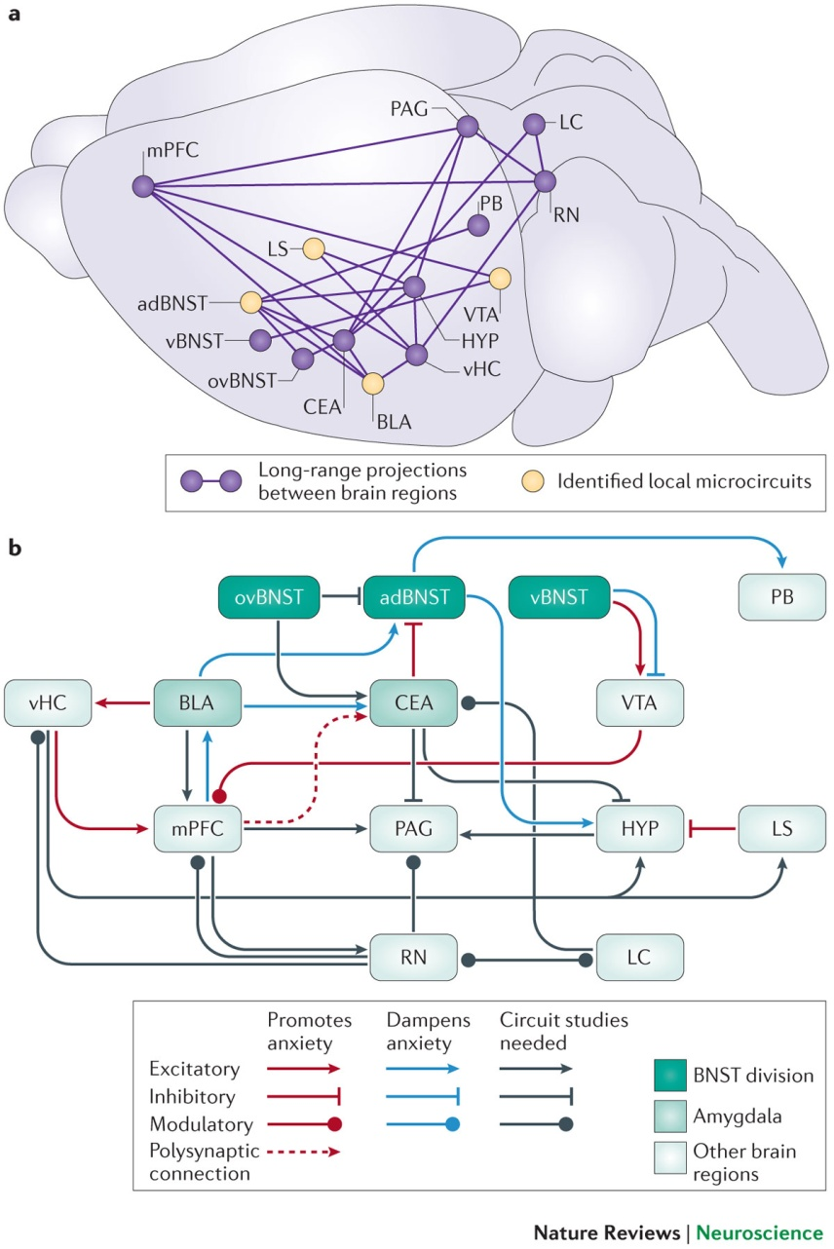
  Distinguishable Neural Circuits/Mechanisms?
Fear Circuitry
Anxiety Circuitry
Tovote, P., et al. 2015. Nature Reviews. Neuroscience 16(6): 317.

Slide 15
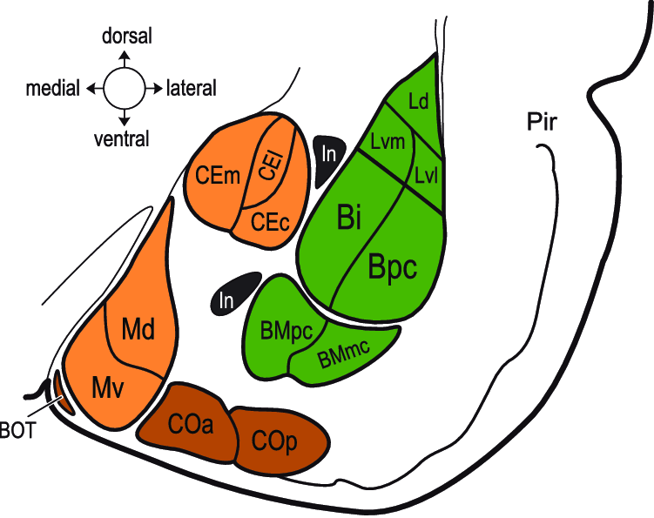
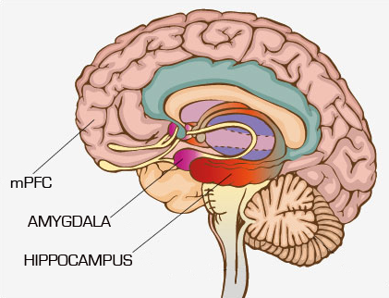
  Distinguishable Neural Circuits/Mechanisms?
Knapska, E., et al. 2007. Physiological reviews 87:1113-1173.

Slide 16
  Distinguishable Neural Circuits/Mechanisms?
+
Fos⁺
Glu
CaMKII⁺
Fos⁺
CaMKII⁺
Glu
+
Fos⁺
CaMKII⁺
+
Glu
Glu = Glutamate
CaMKII⁺ = contains CaMKII protein (glutamatergic)
Fos⁺ = contains Fos protein (active)
+
Fos⁺
CaMKII⁺
Glu

Slide 17
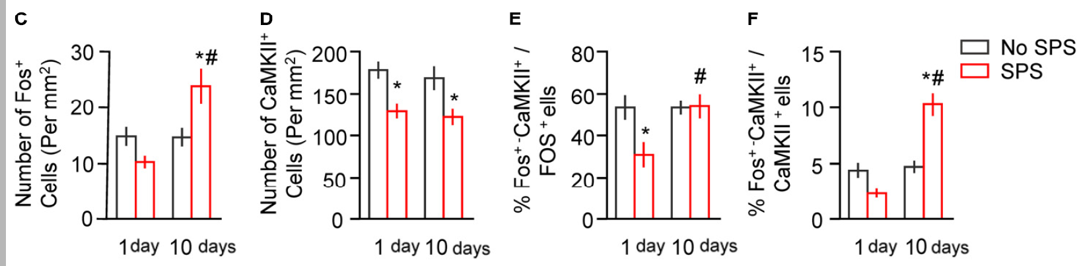
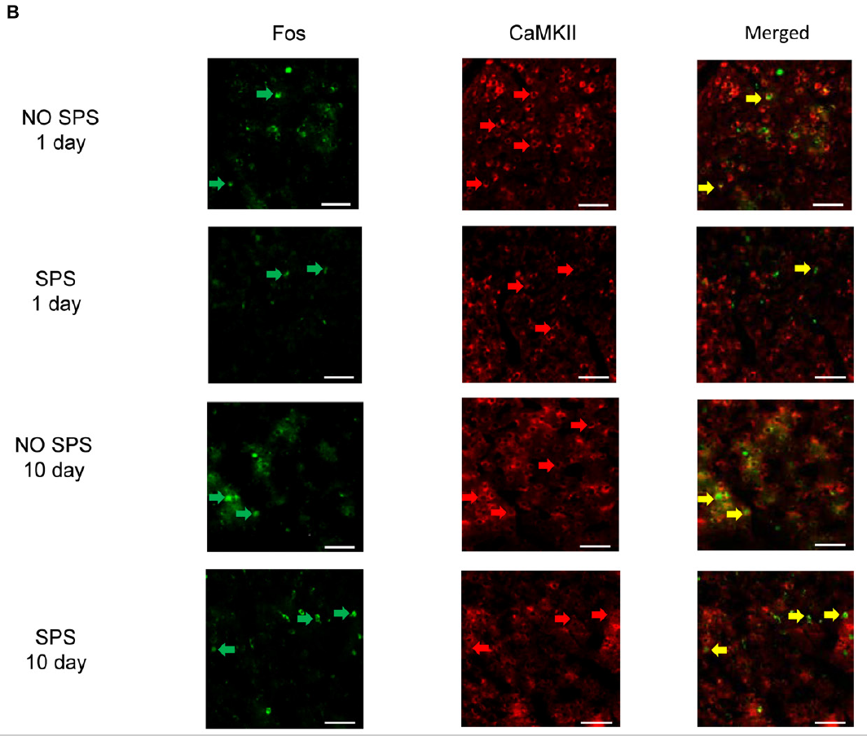
  Distinguishable Neural Circuits/Mechanisms?
Fang, Q., et al. 2018. Frontiers in neuroscience 12:387

Slide 18
  Distinguishable Neural Circuits/Mechanisms?
GAD67⁺
GABA
-
Fos⁺
GAD67⁺
Fos⁺
-
GABA
GABA = GABA
GAD67⁺ = contains GAD67 protein (GABAergic)
Fos⁺ = contains Fos protein (active)
+
(or γ-aminobutyric acid)
GAD67⁺
Fos⁺
Glu

Slide 19
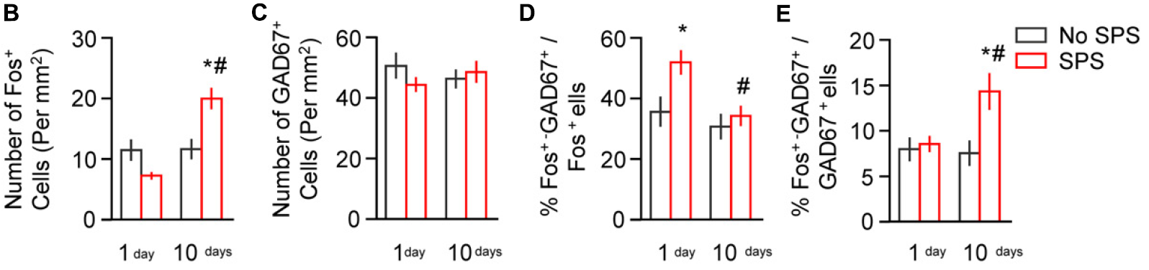
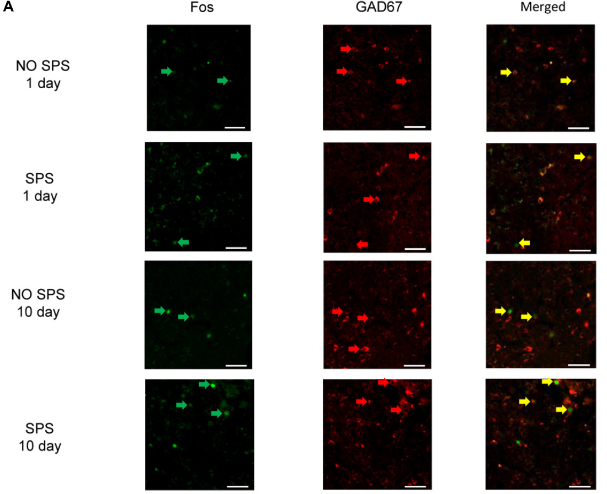
  Distinguishable Neural Circuits/Mechanisms?
While both Glu & GABA cells become activated after SPS...
The proportion of activated neurons favor an excitatory effect
Fang, Q., et al. 2018. Frontiers in neuroscience 12:387

Slide 20
  Distinguishable Neural Circuits/Mechanisms?

Slide 21
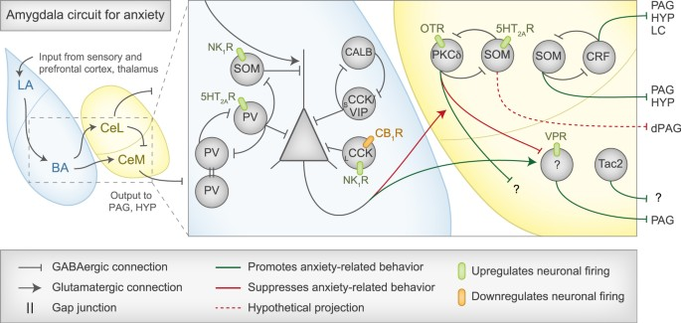
  Distinguishable Neural Circuits/Mechanisms?
Parvalbumin-positive (PV⁺) - co-localized with CB >
Cholecystokinin-positive (CCK⁺) - many have CB₁; co-localized with CB, VIP, and/or CR >
Somatostatin-positive (SOM⁺) - co-localized with CB and/or NPY
Babaev, O., et al. 2018. Experimental & Molecular Medicine 50:18.
Capogna, M. 2014. Current opinion in neurobiology 26:110-116.

Slide 22
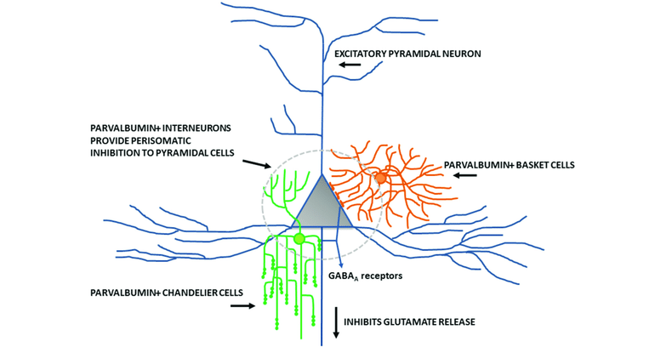
  Distinguishable Neural Circuits/Mechanisms?
MacKay, M. A., et al. 2018. Frontiers in Psychiatry 9:537.

Slide 23
  Distinguishable Neural Circuits/Mechanisms?
-
-
Fear and Anxious Behaviors are regulated through GABAergic tone in the BLA...
However...this tone is controlled by glutamatergic (excitatory) cells...
Distinct molecular mechanisms determine if behavioral output is...
fearful, anxious, or both
-
-
-

Slide 24
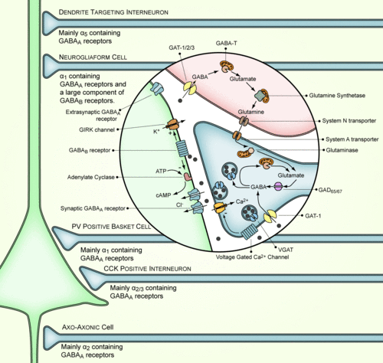
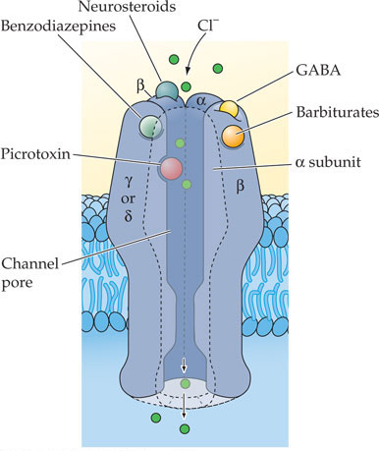
  From Cellular to Molecular

Slide 25
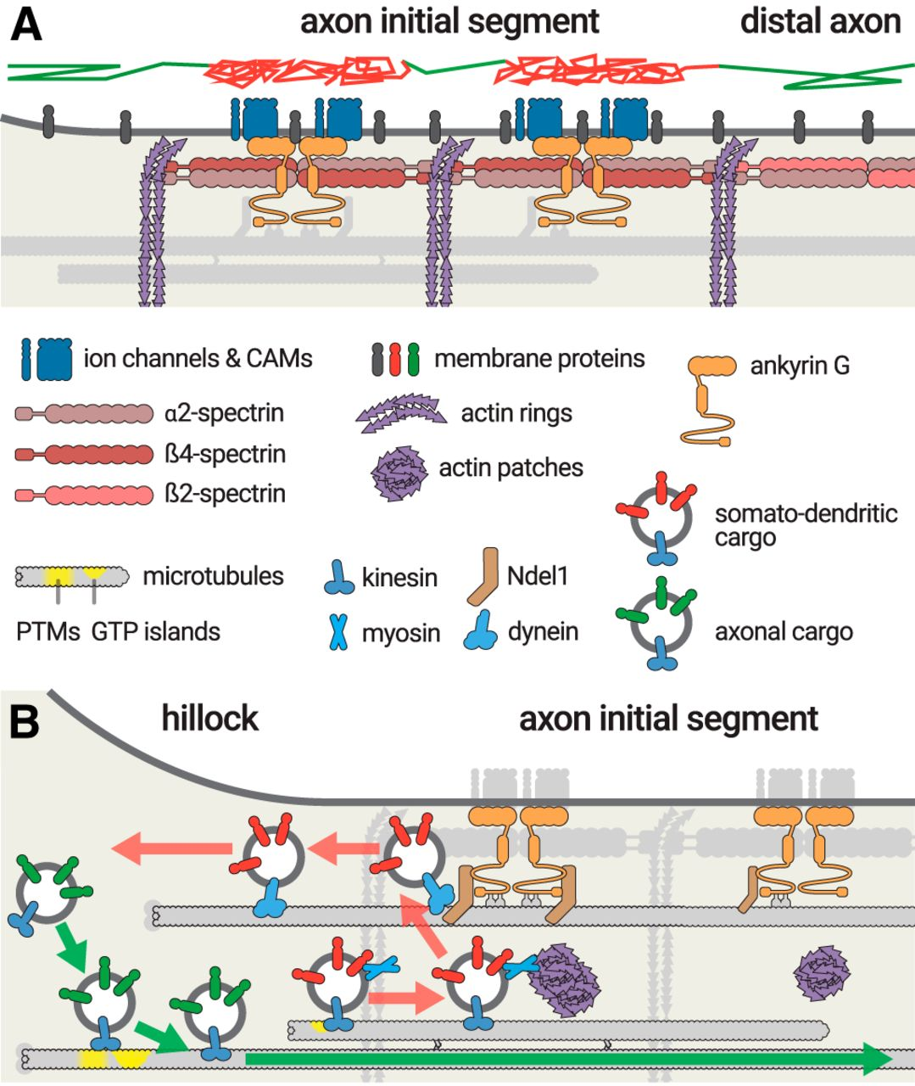
  From Cellular to Molecular
Leterrier, C. 2018, Journal of Neuroscience 38:2135-2145.

Slide 26
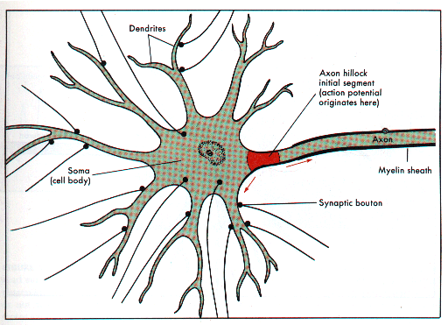
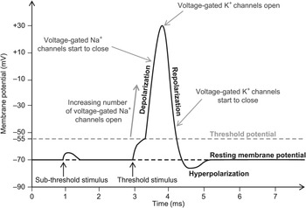
  Axon Initial Segment (AIS)

Slide 27
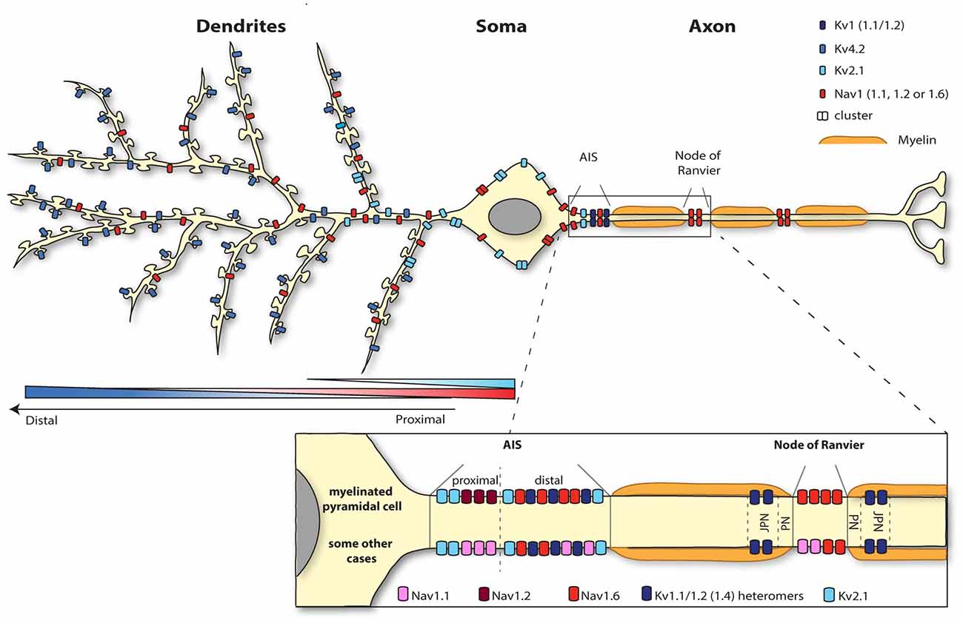
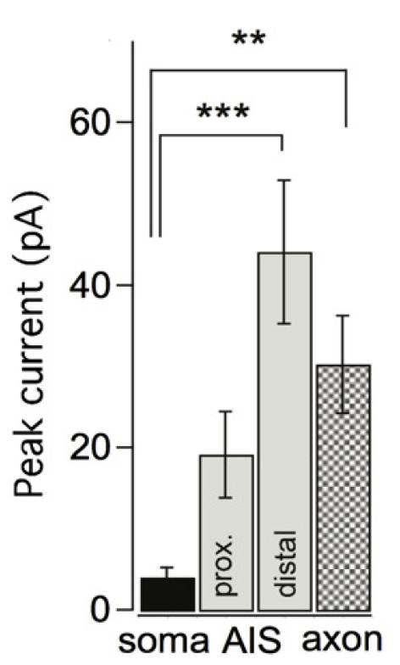
  Axon Initial Segment (AIS)
Duménieu, M., et al. 2017. Frontiers in Cellular Neuroscience 11.
Maarten H. P. Kole, M. H. P. & Stuart, G. J. 2012. Neuron 73:235-247.

Slide 28
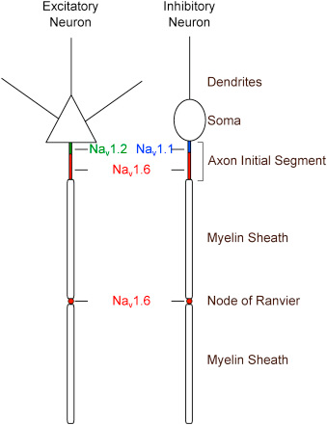
  Axon Initial Segment (AIS)
MacKay, M. A., et al. 2018. Frontiers in Psychiatry 9:537.

Slide 29
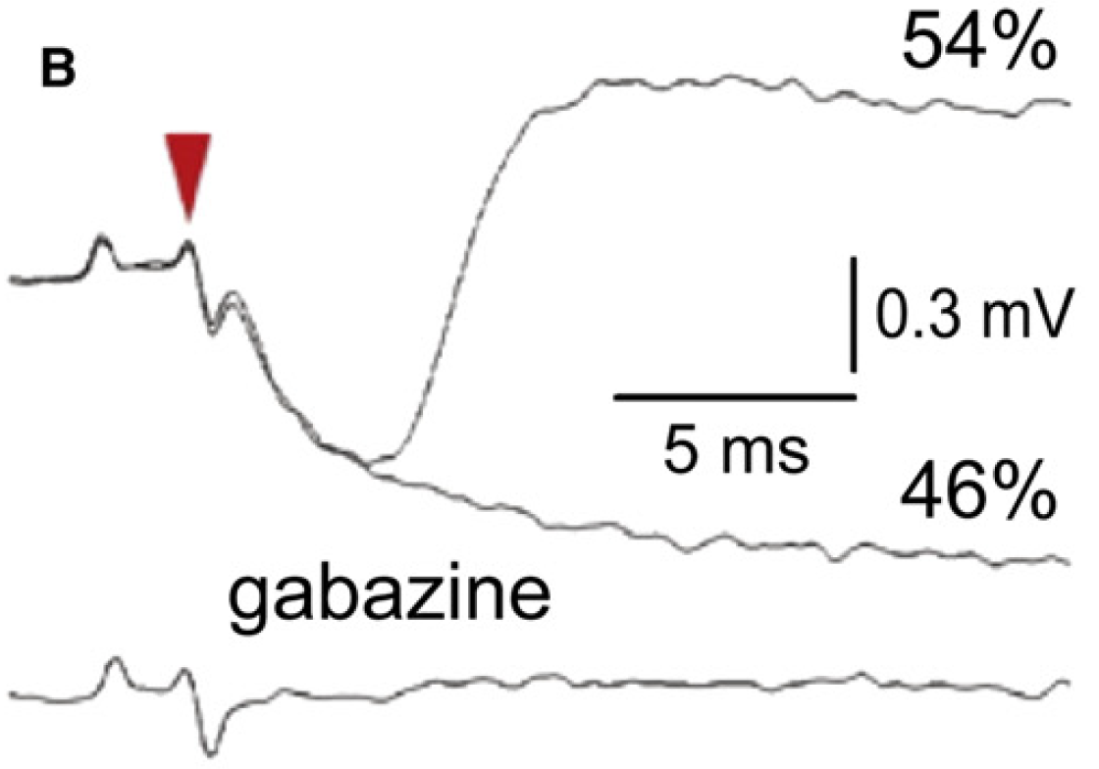
  Axon Initial Segment (AIS)
GABA_{A}
-
+
Maarten H. P. Kole, M. H. P. & Stuart, G. J. 2012. Neuron 73:235-247.

Slide 30
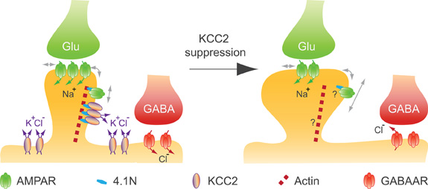
  Axon Initial Segment (AIS)
Maarten H. P. Kole, M. H. P. & Stuart, G. J. 2012. Neuron 73:235-247.

Slide 31
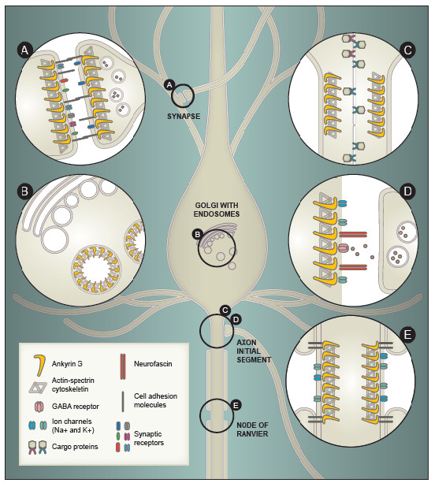
  Axon Initial Segment (AIS)
Leussis, M., et al. 2012. Biology of mood & anxiety disorders 2:18.

Slide 32
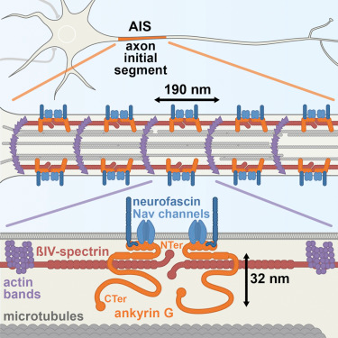
  Neurofascin
Leterrier, C. et al. 2015, Cell Reports 13:2781-2793.

Slide 33
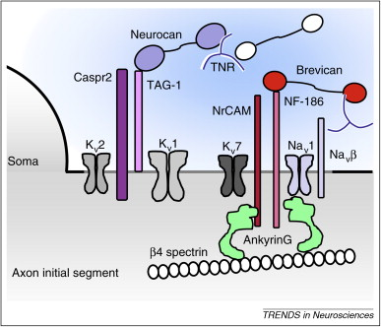
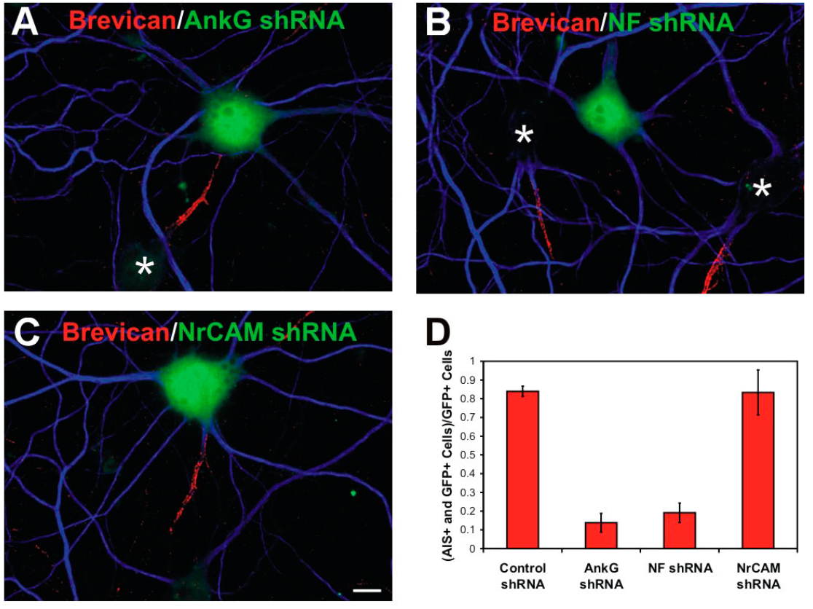
  Neurofascin
Dityatev, A., et al. 2010. Trends in Neurosciences 33:503-512.
Hedstrom, K. L., et al. 2007. J Cell Biol 178:875-886.

Slide 34
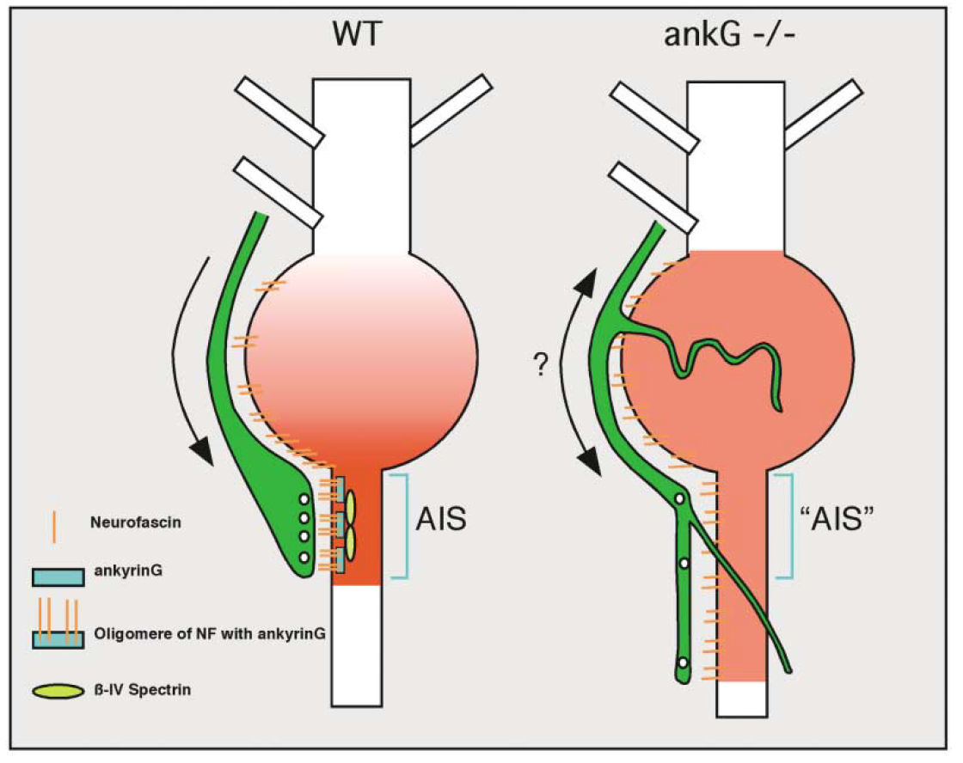
  Neurofascin
Ango, F., et al. 2004. Cell 119:257-272.

Slide 35
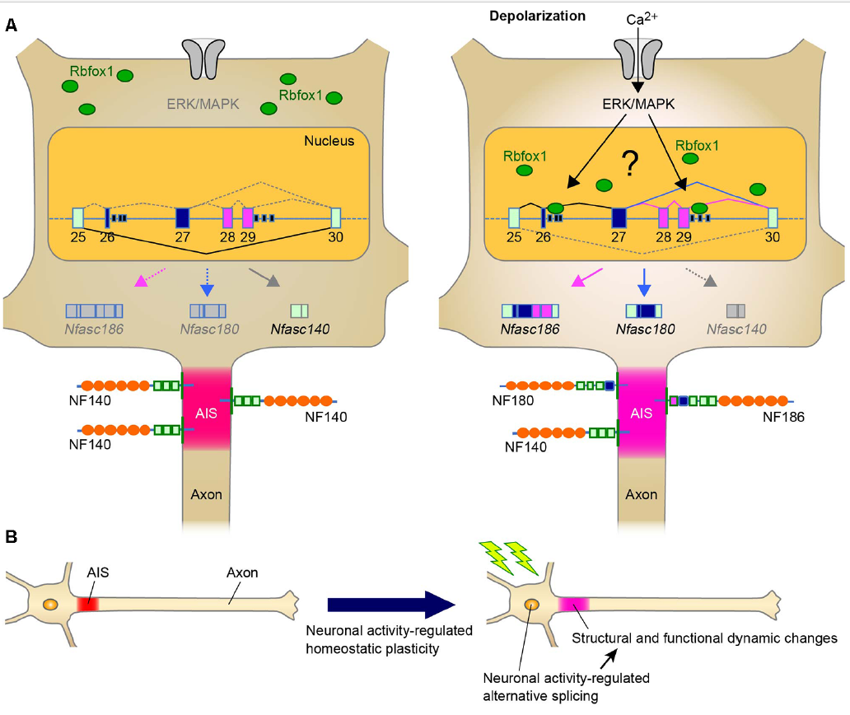
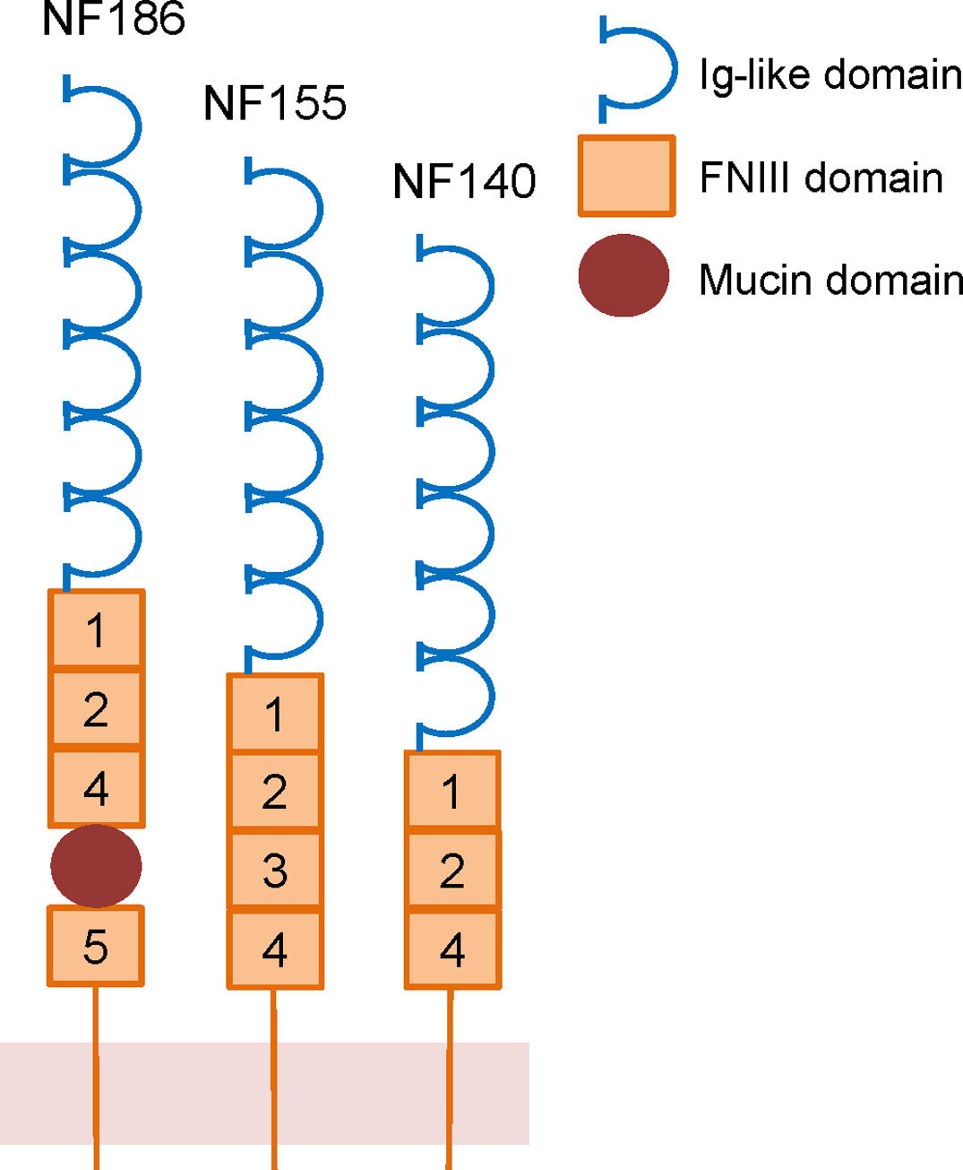
  Neurofascin
50 isoforms result from alternative splicing
4 found in CNS
  3 (NF140, NF180, NF186) in neurons
  1 (NF155) in glia
Conserved 6 Ig-like domains
Differ in variable FNIII-like domains
Differ in presence/absence of PAT domain
Iijima, T. & Yoshimura, T. 2018. Frontiers in Molecular Neuroscience 12.
Yamasaki, R. 2013. Clinical and Experimental Neuroimmunology 4:68-75.

Slide 36
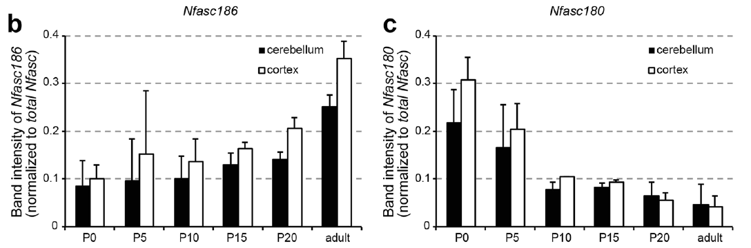
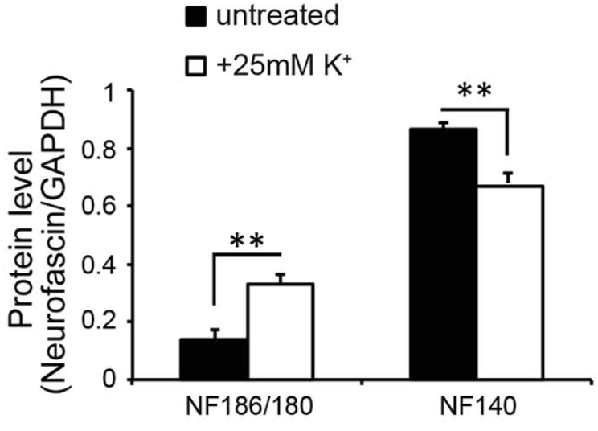
  Neurofascin
Suzuki, S., et al. 2017. Scientific Reports 7: 11405.

Slide 37
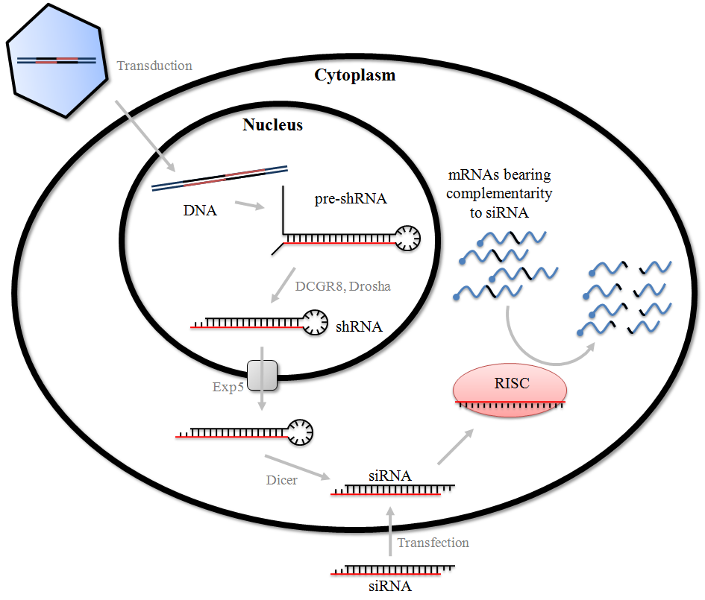
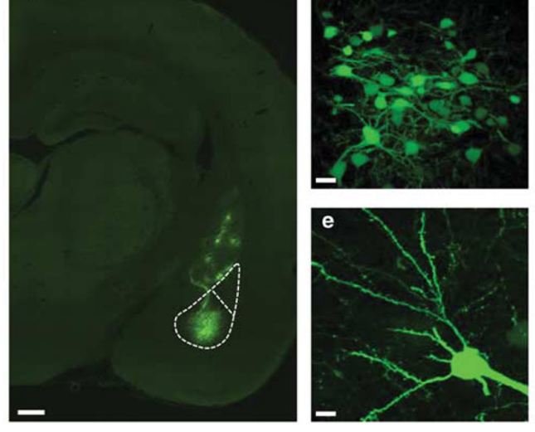

  Neurofascin
NF1196 or NF1707
Saha, R., et al. 2017. Neuropsychopharmacology 42:473-484

Slide 38
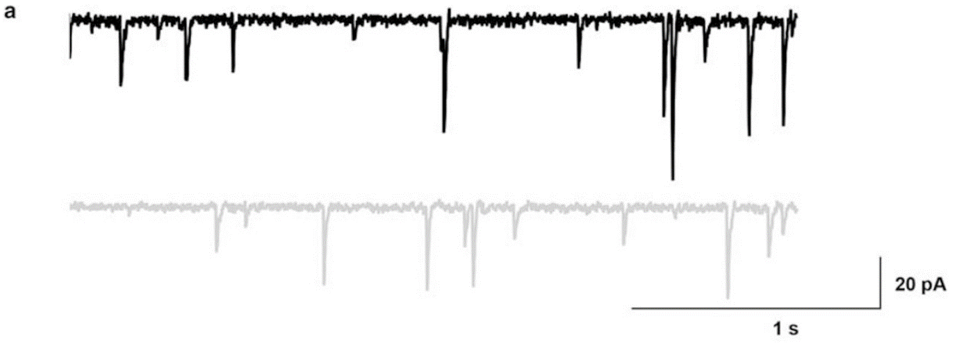
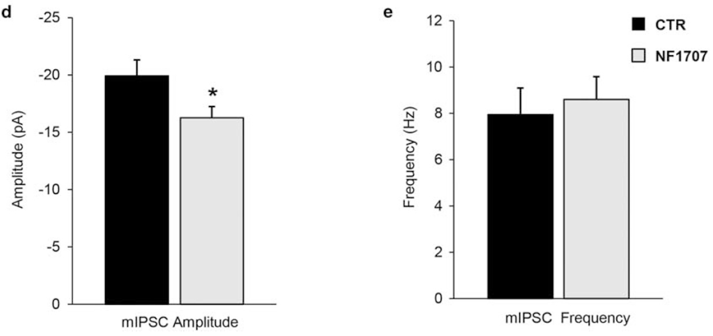
  Neurofascin
Saha, R., et al. 2017. Neuropsychopharmacology 42:473-484

Slide 39
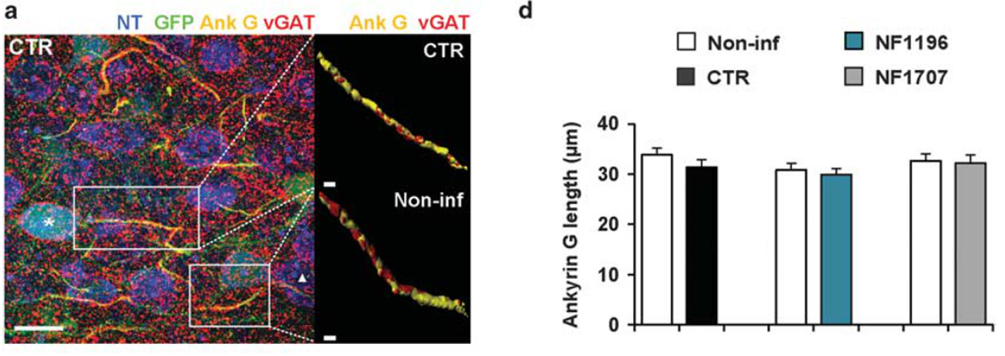
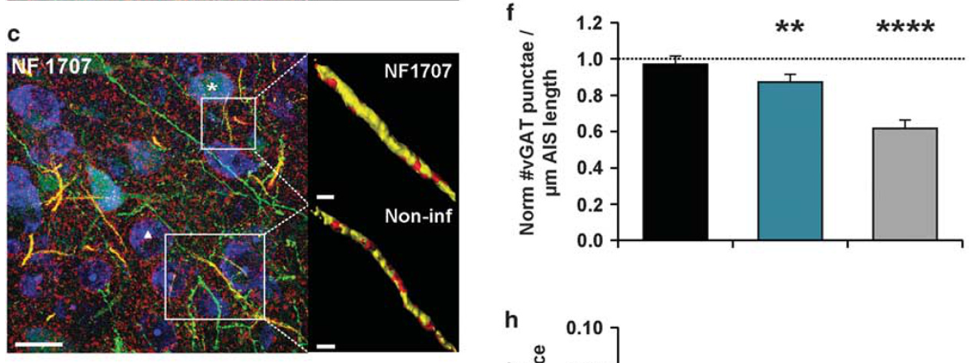
  Neurofascin
vGAT = vesicular GABA transporter
Ank G = Ankyrin G
GFP = green fluorescent protein
NT = Neurotrace
Saha, R., et al. 2017. Neuropsychopharmacology 42:473-484

Slide 40
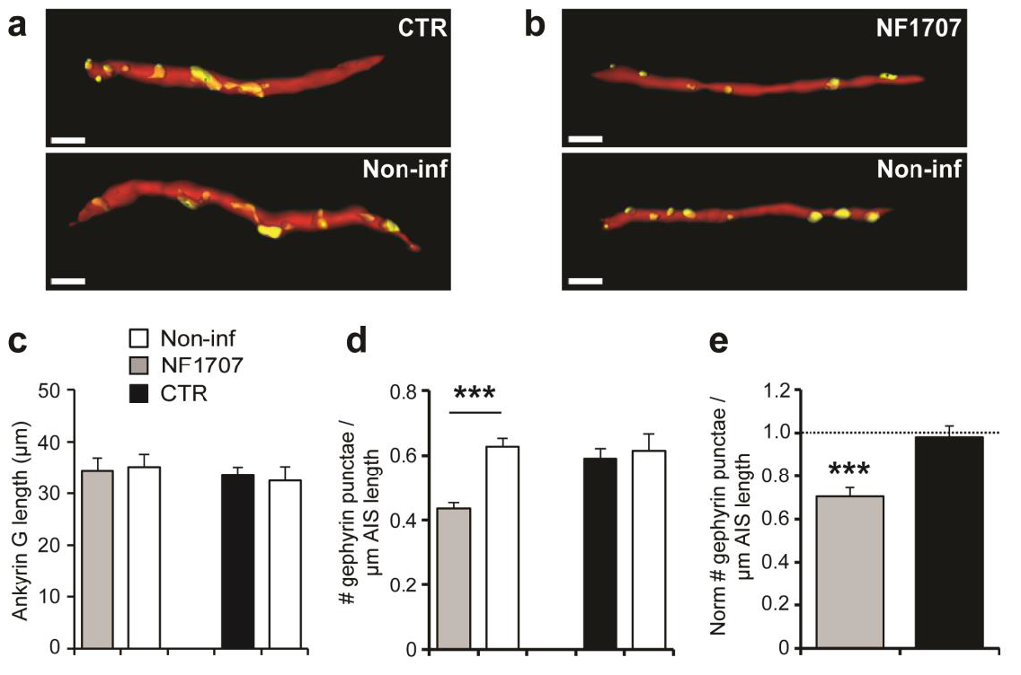
  Neurofascin
What is gephyrin?
Saha, R., et al. 2017. Neuropsychopharmacology 42:473-484

Slide 41
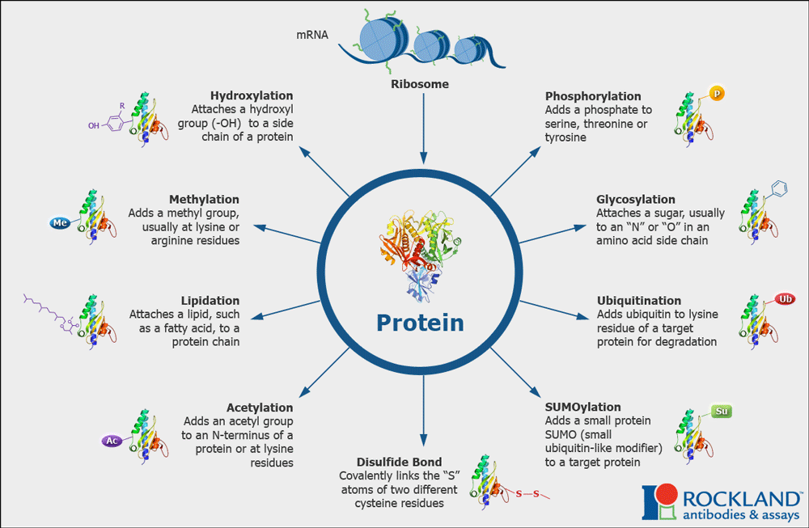
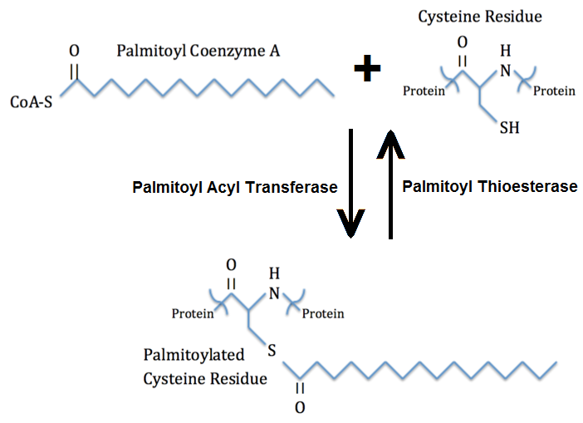
  Palmitoylation
Palmitoylation

Slide 42

  Palmitoylation
Palmitoyl acyltransferases (PATs)
23 in human & 24 in mouse genome
Catalytic zinc finger domain
  aspartate-histidine-histidine-cysteine
    DHHC
Palmitoylation → rapid location changes
  Receptors
  Membrane-bound molecules
  Synapse formation
    PSD (post-synaptic)
    SNAP-25 (pre-synaptic)
Zaręba-Kozioł, M., et al. 2018. Frontiers in Molecular Neuroscience 11.

Slide 43

  Palmitoylation
Shen, Z.-C. et al. 2019. Biological Psychiatry 85:202-213.

Slide 44

  Palmitoylation
= N-(tert-butyl)hydroxylamine hydrochloride
Shen, Z.-C. et al. 2019. Biological Psychiatry 85:202-213.

Slide 45
  Palmitoylation
= N-(tert-butyl)hydroxylamine hydrochloride
Shen, Z.-C. et al. 2019. Biological Psychiatry 85:202-213.

Slide 46



  Gephyrin
Jacob, T., et al. 2008. Nature reviews Neuroscience 9:331-343.
Choii, G. & Ko, J. 2015. Experimental & Molecular Medicine 47:e158-e158.

Slide 47

  Gephyrin
Shen, Z.-C. et al. 2019. Biological Psychiatry 85:202-213.

Slide 48
  Gephyrin
GODZ = Golgi-associated DHHC-type Zinc Finger Protein
Catalyzes palmitoylation of γ2 subunit
C. Fang, C., et al., 2006. Journal of Neuroscience 26:12758-12768.

Slide 49
  Gephyrin
Shen, Z.-C. et al. 2019. Biological Psychiatry 85:202-213.

Slide 50


  Gephyrin
Shen, Z.-C. et al. 2019. Biological Psychiatry 85:202-213.

Slide 51

  Gephyrin
Shen, Z.-C. et al. 2019. Biological Psychiatry 85:202-213.

Slide 52

  Gephyrin
Shen, Z.-C. et al. 2019. Biological Psychiatry 85:202-213.

Slide 53

  Gephyrin
Shen, Z.-C. et al. 2019. Biological Psychiatry 85:202-213.

Slide 54
  Gephyrin
Shen, Z.-C. et al. 2019. Biological Psychiatry 85:202-213.
Notes:
Figure 1

Slide 55

  Where we are...
Neurofascin & Gephyrin are involved in GABAergic synaptic plasticity:
Neurofascin shapes connections with GABA cells (at AIS)
Gephyrin (palmitoylated) anchors GABA receptors to synapse
Palmitoylated Gephyrin is important for anxiolytic responses...
What about Neurofascin?

Slide 56

  Neurofascin and Anxiety
Saha, R., et al. 2017. Neuropsychopharmacology 42:473-484

Slide 57

  Neurofascin and Anxiety
Saha, R., et al. 2017. Neuropsychopharmacology 42:473-484

Slide 58

  Neurofascin and Fear
Saha, R., et al. 2017. Neuropsychopharmacology 42:473-484

Slide 59

  Neurofascin and Fear
Saha, R., et al. 2017. Neuropsychopharmacology 42:473-484

Slide 60


  Neurofascin vs Gephyrin
Neurofascin
Neurofascin
?
Gephyrin
Gephyrin

Slide 61

  Gephyrin and Fear
Chhatwal, J. P., et al. 2005. Journal of Neuroscience 25:502-506.

Slide 62

  Gephyrin and Fear
Chhatwal, J. P., et al. 2005. Journal of Neuroscience 25:502-506.

Slide 63
  Conclusions
In the BLA:
Both Neurofascin & Gephyrin shape GABA synapses
Neurofascin-associated plasticity → normal/healthy fear extinction
  Bridging GABA terminals to AIS
Gephyrin-related plasticity → normal/healthy fear & anxiety
  Anchoring GABA_{A} receptors to synaptic site
Caveats
Region Specificity
Axo-axonic vs Perisomatic
Contribution of other Molecular Structures

